Slide 1
CSE 2102: Introduction to Software Engineering
Software Verification
Integration Testing

Slide 2
Testing in the large: Testing and Modularity
Application of testing in the small techniques to large systems results in extreme complexity
We need techniques to master the complexity of verification of large software systems
Software architecture of the system may be used to drive verification.
  Test modules individually, and then the whole system
Benefits of modular testing:
  Easier to localize errors
  Easier to discover errors early in the development
  Easier to classify errors as to their scope
Good design techniques enhance verifiability.
Notes:
Remember that a well-designed software system is composed of modules. Whatever testing techniques, namely, black-box and white-box techniques that we have described so far are good to test each individual module. However, if we try to apply the same techniques to test a collection of modules which is necessary to make sure that these collections work together, then that results in a very complex situation. Thus, we need different techniques to test the collection of modules.
Just as a good software design is modular, this modular design could drive verification too. Thus, we should be able to test each module in isolation and then test the collection of modules incrementally. The advantages of modular testing are many. Firstly, we can determine which module is a cause of an error. Because development proceeds in a modular fashion, we can test a module as soon as it becomes available rather than waiting for all the system to be completely implemented. Also, it becomes easier to determine whether the error occurred due to a misunderstood requirement, coding error etc. Thus, if we use good design techniques we are not only likely to produce a system which contains fewer errors, but the errors which will inevitably creep in will be easier to detect and fix.

Slide 3
Testing in the large: Testing and modularity
Module testing: Verifies whether a module has been implemented correctly with respect to external behavior
Integration testing: Testing that occurs as a system is being gradually integrated.
System testing: Verifies whether a collection of modules (the entire system) behaves properly
  Usually executed in an actual delivery environment, by the development organization.
Acceptance testing: System testing that is mainly performed by a customer to see if it meets the customer expectations.
Notes:
Before we start describing the techniques to perform testing on a collection of modules taking into consideration their relationships, I will first describe some common terminology that is used in the testing community. The first term that is used is module testing. Module testing consists of testing an indiviudal module to determine whether it correctly provides the functionality stated in the interface. The next aspect is integration testing. As modules get developed, we start to integrate the modules into the system. We do not integrate all modules at once, but rather we integrate the modules incrementally. This incremental testing of a collection of modules is known as integration testing. When all the modules are integrated, we test the entire system by driving the system with a representative suite of test cases, stress the system with adequate levels of load etc,., just how it is likely to be used by a customer. However, system testing is performed by the developer at his/her own site.
Acceptance testing is performed by a customer together with a developer before the customer accepts the product.

Slide 4
Module testing
Modules often cannot be tested in isolation
May need to provide a temporary context in which the module might execute
  Any modules it calls that do not belong to it
  Access to non local data structures
  Simulate a call to the module itself
Notes:
Remember that I mentioned that as and when a module becomes available it must be tested. However, it may not be completely possible to test the module in isolation. For example, if we recall the USES relationship, then the module may use the services provided by the other module. Then until this other module becomes available, we cannot test our module. Or the module may access and use data structures defined some other modules. Then the module which defines the data structures becomes available, we cannot test our module. This happens because a module often has to function in a context. If the module were to be able to function in isolation, it may not be necessary in the system. Thus, for the purpose of testing, we may have to provide this context.

Slide 5
Module testing (contd..)
Stub: Procedure that has the same I/O parameters as the missing
module but simplified behavior
Driver: Piece of code that simulates the use of module being tested by
other modules in the system and gets shared data
PROCEDURE
STUB
UNDER TEST
DRIVER
CALL
CALL
ACCESS TO NONLOCAL
VARIABLES
Harness or scaffolding: Support software developed for a module and
integration testing
Notes:
When we talk of the context of a module, recall that a module may use other modules, or it may be used by the other modules. In the former case, if the module uses other modules, then we may need a simplified module which provides the same I/o behavior as the used module. This simplified module is known as a stub. On the other hand, if the module is being used by other modules, then we may need to simulate the calls to this module. The procedure used to call the module is known as a driver. In general, the support software that is necessary to test a module is known as scaffolding or test harness.

Slide 6
Integration testing
Big-bang testing: Test individual modules then the entire system
  No integration testing
  All inter-module dependencies tested during system test phase
  Many interactions leading to high complexity
Incremental testing: Application of incrementality principle to integration testing
  Modules are developed incrementally and should be tested incrementally
  Easier to localize errors incrementally
  Partial aggregation of modules may constitute important subsystems that have autonomy
  Reduces the need for stubs and/or drivers
  Can proceed both bottom-up and top-down
Notes:
There are two approaches to integration testing.

Slide 7
Bottom-Up vs. Top-Down Aggregation
Bottom-up aggregation:
  Modules at the lowest level of the hierarchy are integrated to form the system.
  USES hierarchy is employed.
  Need drivers.
Top-down aggregation:
  Topmost level modules to lowest level,
  Need stubs.
Do we use top-down and bottom-up approaches exclusively?

Slide 8
Bottom-up vs. Top-down Aggregation
Top-down integration advantages:
  May anticipate early design errors.
  Early prototype, may be demonstrated to the end user.
Top-down testing disadvantages:
  Usually tests without I/O operations.
  Decreases both the reliability of the testing results
Bottom-up testing advantages and disadvantages:
  Observation and evaluation are easier.
  Also easier to lose sight of the bigger picture.

Slide 9
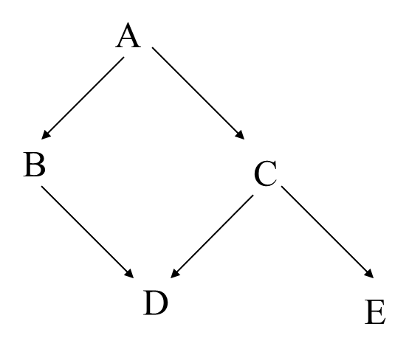
Integration testing – Example #1
How the USES relationship can be exploited for integration testing using the bottom up or top down aggregation strategy
In the bottom-up aggregation strategy:
Implement D, E and test using drivers for D, E
Implement B and C, test using drivers for B and C
Implement A, and test the whole system.
If integration and test proceed bottom up, we need only drivers.

Slide 10
Integration testing – Example #1
How the USES relationship can be exploited for integration testing using the bottom up or top down aggregation strategy
In the top-down aggregation strategy:
In the top-down aggregation strategy:
Implement A, test using stubs for B and C.
Implement B and C, test using stubs for D and E.
Implement D and E, test the whole system.
If integration and test proceed top down, we need only stubs.

Slide 11
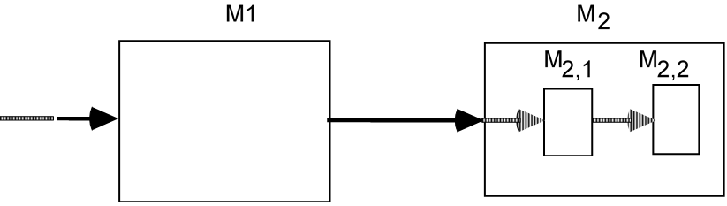
Integration testing – Example #2
Relationship between USES, IS_COMPOSED_OF and integration testing.
M1 USES M2 and M2 IS_COMPOSED_OF {M2,1, M2,2}.
Usually, it helps to represent the relationships among the modules diagrammatically, before devising a strategy.

Slide 12
Integration testing – Example #2
M1 USES M2 and M2 IS_COMPOSED_OF {M2,1, M2,2}.
CASE I
Test M1, providing a stub for M2 and a driver for M1.
Then implement and test M2,1 using a stub for M2,2
CASE II
Implement M2,2 and test it by using a driver for M2,2
Implement M2,1 and test the combination of M2,1 and M2,2
(i.e., M2) by using a driver for M2.
Finally, implement M1 and test it with M2, using a driver for M1.

Slide 13
Separation of concerns in testing
In general, testing involves several phases, with different goals, performed by different people
Use principle of separation of concerns to design test cases for different qualities:
  Performance
  Robustness
  User friendliness
A sample of different concerns
  Overload testing: Test how the system behaves during peak conditions
  Robustness: Test system under unexpected conditions
    Erroneous user commands
    Power failure
  Regression testing: Test to verify degradations of correctness or other qualities due to later modifications
Notes:
As discussed in Chap. 3, the principle of separation of concerns should be applied throughout the software development lifecycle. That applies to testing as well. The goals of testing are many-fold, though testing is often confused with verifying the functional correctness of the software. However, testing also needs to be performed in order to determine the performance, robustness user-friendliness etc. When we apply the separation of concerns principle for different goals of testing, we should design separate test cases to address each one of these concerns. We should not try to address multiple concerns using the same test case. The goals of different types or kinds of testing are different. For example, in overload testing we should test how the system behaves under peak conditions, whether it still provides acceptable performance or not. When we are testing the system for robustness we should determine whether the system behaves reasonably under unexpected conditions. In this case, we should test the system by simulating unexpected conditions such as erroneous user commands, and even extreme conditions such as power failure. Another type of testing that is usually performed is also known as regression testing, where when we add any new features, or improve any existing features or just modify some piece of code, we should verify that the original features as well as the original performance remains undegraded.

Slide 14
Testing concurrent systems
General testing principles are applicable to concurrent systems
Concurrent systems are more difficult to specify and design than sequential systems
Issue of repeatability is critical in concurrent systems
  Non-determinism is the primary cause
  Concurrent systems have nondeterministic behavior
  Same input will not always produce same output
  Means a test case might identify an error in one run and not if repeated
Notes:
The same general principles of testing that we discussed earlier apply in the context of concurrent systems. However, the main difference between concurrent systems and sequential systems is non-deterministic behavior. Concurrent systems have non-deterministic behavior due to which, if the same test case is executed multiple times it may produce a different answer. Thus, in one run, the test case identifies an error whereas in another run the test case may not identify an error. The issue of non determinism is even more problematic when we are testing in the large due to multiple modules running simultaneously.

Slide 15
Testing real-time systems
General testing principles are applicable to real-time systems
Because performance is as critical if not more critical in real-time systems, verification of real-time systems must take into account implementation details
  Scheduling policies
  Machine architecture
  CPU speed
Completeness must be attained from processing speed point of view
Notes:
In the context of real-time systems obtaining the correct output is just as important as obtaining it before the deadline. Thus, not only the functional correctness must be verified, but also, the performance requirements must be verified. The performance requirements will depend on additional things such as the scheduling policies of the tasks, the architecture of the underlying hardware and the speed of the hardware. Thus, a real-time system has to be tested separately for every hardware configuration, architecture and scheduling policy that it is to be deployed on.

Slide 16
Testing object-oriented systems
General testing principles may be applied to object-oriented systems
Classes are similar to components in the traditional approach
Testing in the small: Testing each class by calling all the methods of a class
  May need to add new methods for testing purposes
  May require other classes to be stubbed in.
Testing in the large: Organizing the testing activity according to the class structure and interactions
  Inheritance
  Class interactions
  Separation of public interface and private implementation may make testing all execution paths difficult
Notes:
Object-oriented programs take the concept of modularization, information hiding, encapsulation etc. to new heights. This poses new challenges for testing OO systems which we will discuss later. First let us see how the general testing principles that we have discussed so far apply in the context of object-oriented systems. For testing in the small, each class of an OO system can be considered to be an individual module or a component, and the goal of testing in the small should be test all the methods in the class. Remember, methods encompass the behavior of the class. Thus, the methods of the class must be tested by invoking those methods. Also, we may have to write additional methods for testing the remaining methods. Sometimes, the methods can only be tested if some other objects invoke those methods. In this case, the other classes may have to be stubbed in.
Testing in the large consists of testing how the classes interact with each other. In addition to the interactions among the classes that occur at run time, we must also consider how the classes themselves are related to each other by inheritance and polymorphism.

Slide 17
Testing Object-Oriented Systems
Black-box testing:
  Test the public interface.
  Complete coverage principle may be applied by testing every function in the public interface.
White-box testing:
  Test the correctness of the hidden implementation.
  Ignore whether public interface meets specifications.

